Slide 1
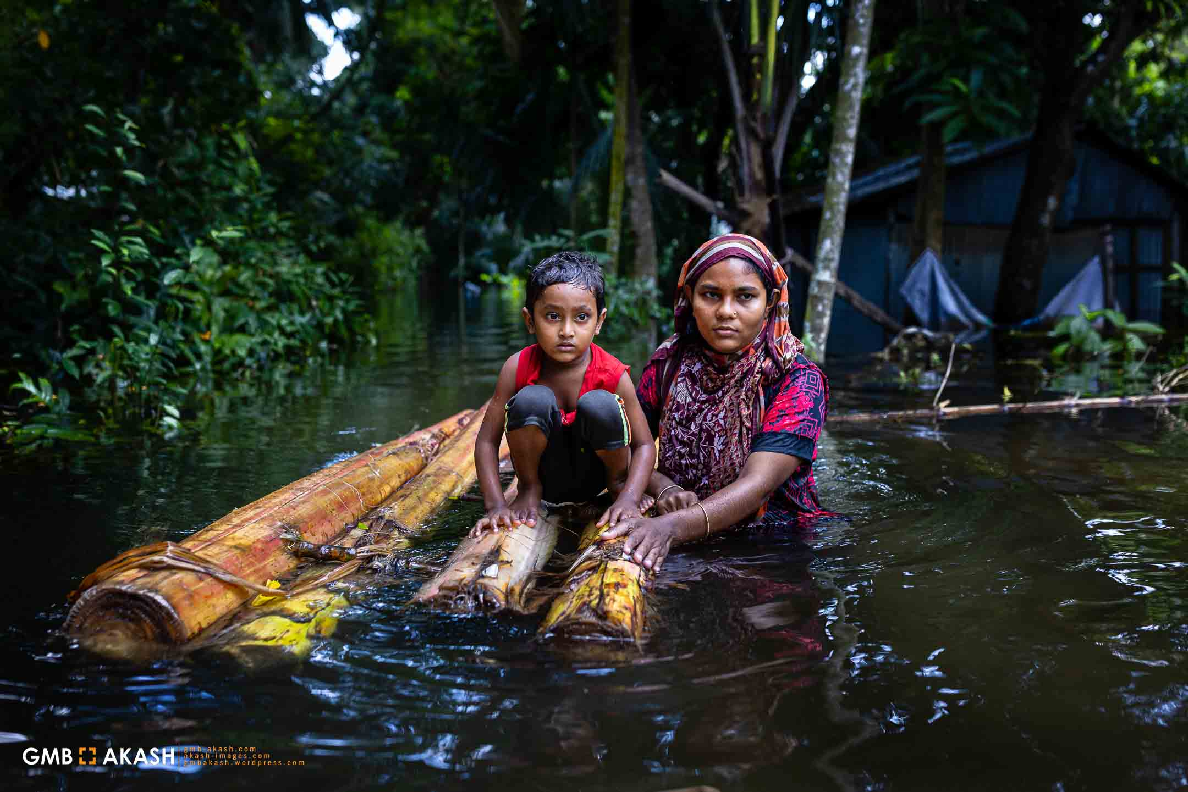
Risk-Based Zoning of the August 2024 Flood in Bangladesh
Course Code: WFM 6201
Course Name: Hazards and Risk Analysis
[
Submitted to
Dr. M. Shahjahan Mondal
Professor
IWFM, BUET
Presented by
0424282207 (CMRM) Hamza Ibn Mujib
0424282215 (CMRM) Md. Samsul Alam Dipu
0424282216 (CMRM) Rifat Al Mahmud
0424282219 (CMRM) Murshida Munni
0424282240 (CMRM) Asadullahil Galib Fardin
0424282107 (WRD) Rafia Islam
0424282120 (WRD) Zubair Al Mahmud
0424282136 (WRD) Nayem Bin Sayed

Slide 2

Presentation Outline
Introduction
Background of Study
Objectives
Methodology
Map Generation
Discussion and Conclusion

Slide 3
INTRODUCTION
As Bangladesh is a riverine country, Floods are a major natural disaster in Bangladesh.
August 2024 floods severely impacted southeastern districts (Noakhali, Feni, Cumilla)
Caused displacement, loss of lives, economic damage, and infrastructure destruction
Primarily it was found that around 11 districts have faced the consequences of this flood.

Slide 4
BACKGROUND OF STUDY
UNDP (2024): Bangladesh faces frequent river and flash floods due to monsoons and low-lying geography
Uddin & Matin (2021): GIS-based flood hazard zoning is essential for disaster risk mitigation
FAO (2024): Flooding severely affects agriculture, causing economic distress
Previous Studies Highlight: Importance of GIS-based mapping

Slide 5
OBJECTIVES
To Assess the Impact of the August 2024 Floods
To Construct GIS-Based Risk Maps
To Identify the Flood Risk of different Districts and Zones
To Evaluate the Relationship Between Impact and Likelihood by combined mapping

Slide 6
METHODOLOGY
Selection of Flood Area
Flood Damage Data for Different Districts
Data Collection
Likelihood For different Districts
Impact Parameters Normalization & Ranking
Calculation
Risk Scoring & Matrix
Risk Map Generation

Slide 7
DATA
Districts | Parameters
 | People Affected | People Displaced | %Area Flooded
Feni | 1000000 | 205,745 | 78
Cumilla | 1060000 | 14,871 | 71.5
Lakshmipur | 723,000 | 73,040 | 100
Khagracchari | 123,992 | 8,130 | 77.77
Noakhali | 2130000 | 120,493 | 92.04
Moulivibazar | 257,993 | 80,000 | 60
Habiganj | 70,240 | 24000 | 40
Brahmanbariya | 64,829 | 120 | 10
Sylhet | 66,000 | 4000 | 39.4
Chattogram | 262,400 | 250,000 | 73
Cox's Bazar | 148,450 | 31,000 | 62.5

Slide 8

DATA NORMALIZATION
The data obtained from various secondary sources were normalized by using a method called Feature Scaling, which is also known as min-max normalization
Also known as min-max scaling or min-max normalization, rescaling is the simplest method and consists in rescaling the range of features to scale the range in [0, 1] or [a, b].
To rescale a range between an arbitrary set of values [a, b], the formula becomes:

Slide 9
DATA NORMALIZATION
Using the min-max formulae the damage data were normalized
The minimum damage data was assigned as variable a and the maximum value was assigned as b in Microsoft Excel.
The impact of the data was calculated between 1 to 5 where 1 denoted the minimum damage impact and 5 denoted the highest.
In all three cases, the districts Feni, Lakshmipur and Noakhali more or less showed larger impact values indicating high damage in area, livelihoods and displacements.

Slide 10
DATA NORMALIZATION
Districts | Area Flooded (%) | Impact Level (Normalized)
Feni | 78 | 5
Lakshmipur | 100 | 5
Noakhali | 92.04 | 5
Moulivibazar | 60 | 4
Habiganj | 40 | 3
Chattogram | 73 | 4
Sylhet | 39.4 | 3
Khagracchari | 77.77 | 5
Cumilla | 71.5 | 4
Cox's Bazar | 62.5 | 4
Brahmanbariya | 10 | 1
Table: Normalized Impact of Percentage of Flooded Area

Slide 11
RISK MATRIX GENERATION
Key
 | Very High
 | High
 | Medium
 | Low
The Risk Index was calculated by the following formula:
Risk (R) = Hazard (H) * Vulnerability (V)
Hazard (H) = Relative Likelihood
Vulnerability(V) = Relative Impact (Damage)
Four different risk zones were determined using different range of risk scores.

Slide 12
RISK MATRIX GENERATION
Relative Impact | 5 | 5 | 10 | 15 | 20 | 25 |  | Key
 | 4 | 4 | 8 | 12 | 16 | 20 |  |  | Very High
 | 3 | 3 | 6 | 9 | 12 | 15 |  |  | High
 | 2 | 2 | 4 | 6 | 8 | 10 |  |  | Medium
 | 1 | 1 | 2 | 3 | 4 | 5 |  |  | Low
 |  | 1 | 2 | 3 | 4 | 5
 | Relative Likelihood
Risk Score Ranges
16-25
12-15
6-10
1-5
 | Very High
 | High
 | Medium
 | Low

Slide 13
RISK MATRIX GENERATION
Key
 | Very High
 | High
 | Medium
 | Low
Districts | Area Flooded (%) | Impact Level | Likelihood (H) | Risk Index (R)
Feni | 78 | 5 | 4 | 20
Lakshmipur | 100 | 5 | 4 | 20
Noakhali | 92.04 | 5 | 4 | 20
Moulivibazar | 60 | 4 | 3 | 12
Habiganj | 40 | 3 | 4 | 12
Chattogram | 73 | 4 | 2 | 8
Sylhet | 39.4 | 3 | 2 | 6
Khagracchari | 77.77 | 5 | 1 | 5
Cumilla | 71.5 | 4 | 1 | 4
Cox's Baza | 62.5 | 4 | 1 | 4
Brahmanbariya | 10 | 1 | 3 | 3
Table: Generation of Risk Index (R)

Slide 14
RISK MAP GENERATION
The ArcGIS geospatial software was used to produce the risk maps for the three different types of damages and one for their combined effects
The values of the Risk Index (R) were inserted into the Attribute Table of the selected districts and colors were assigned as per the Risk Matrix

Slide 15
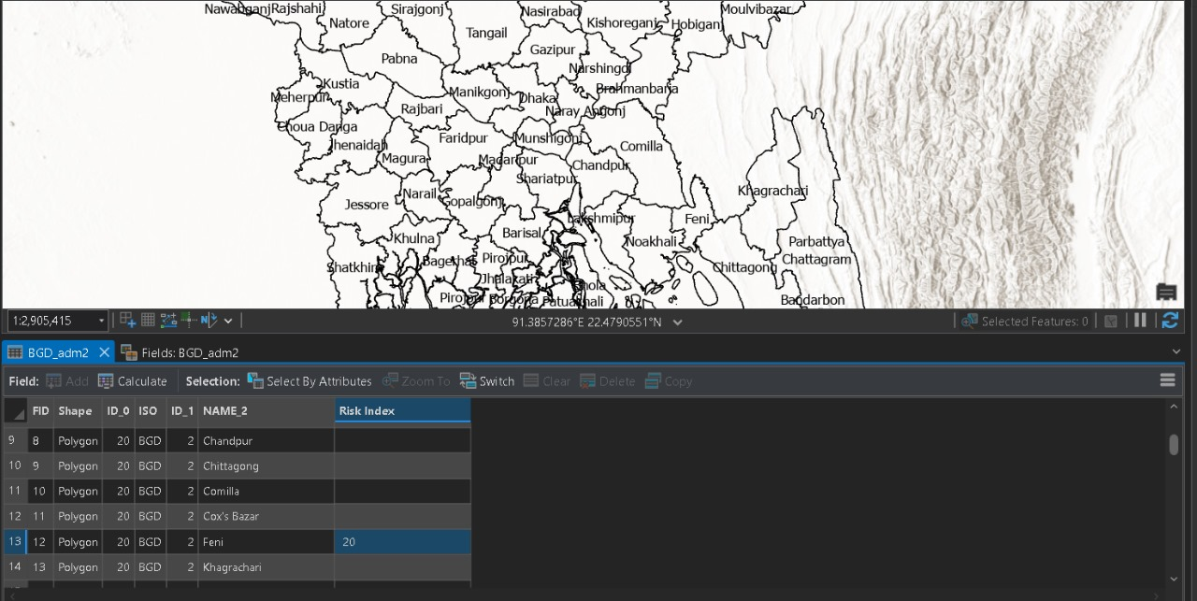
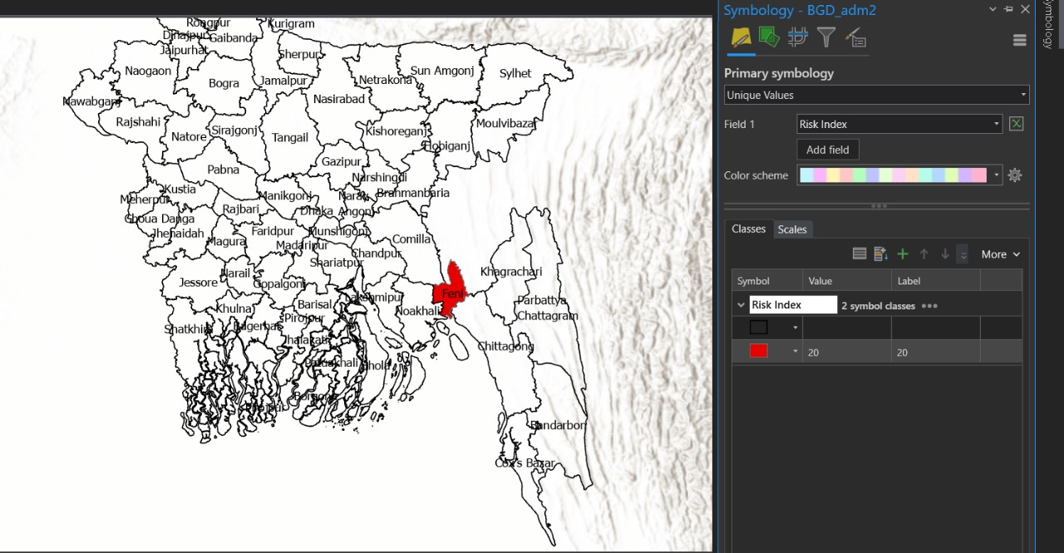
RISK MAP GENERATION

Slide 16
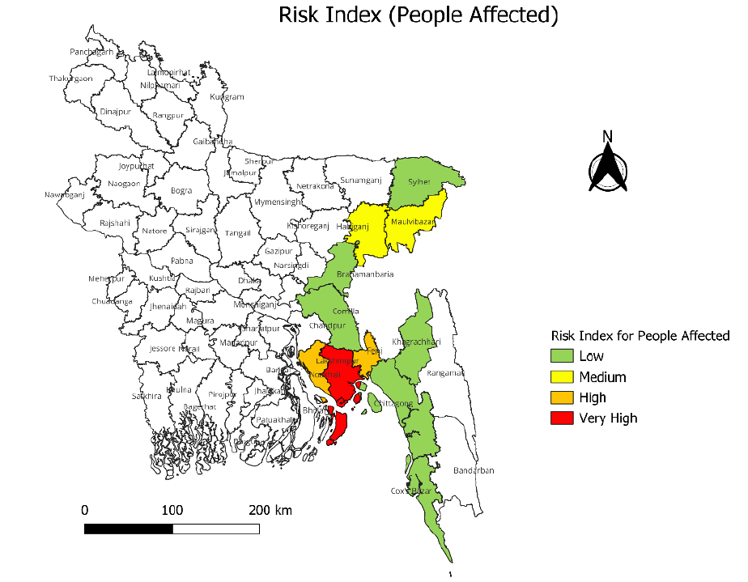
INDIVIDUAL RISK MAP

Slide 17
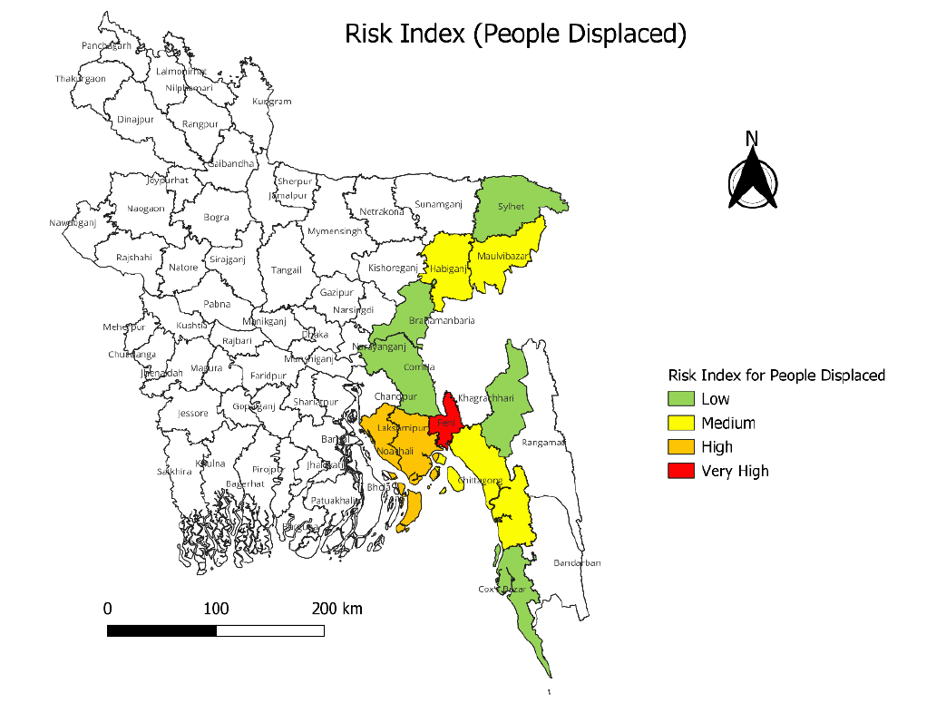
INDIVIDUAL RISK MAP

Slide 18
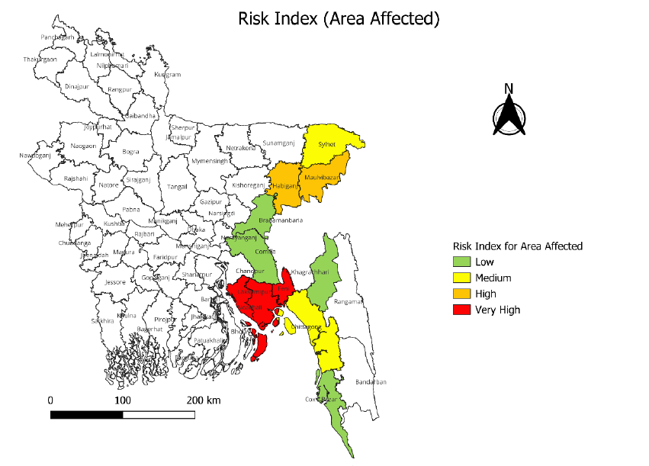
INDIVIDUAL RISK MAP

Slide 19
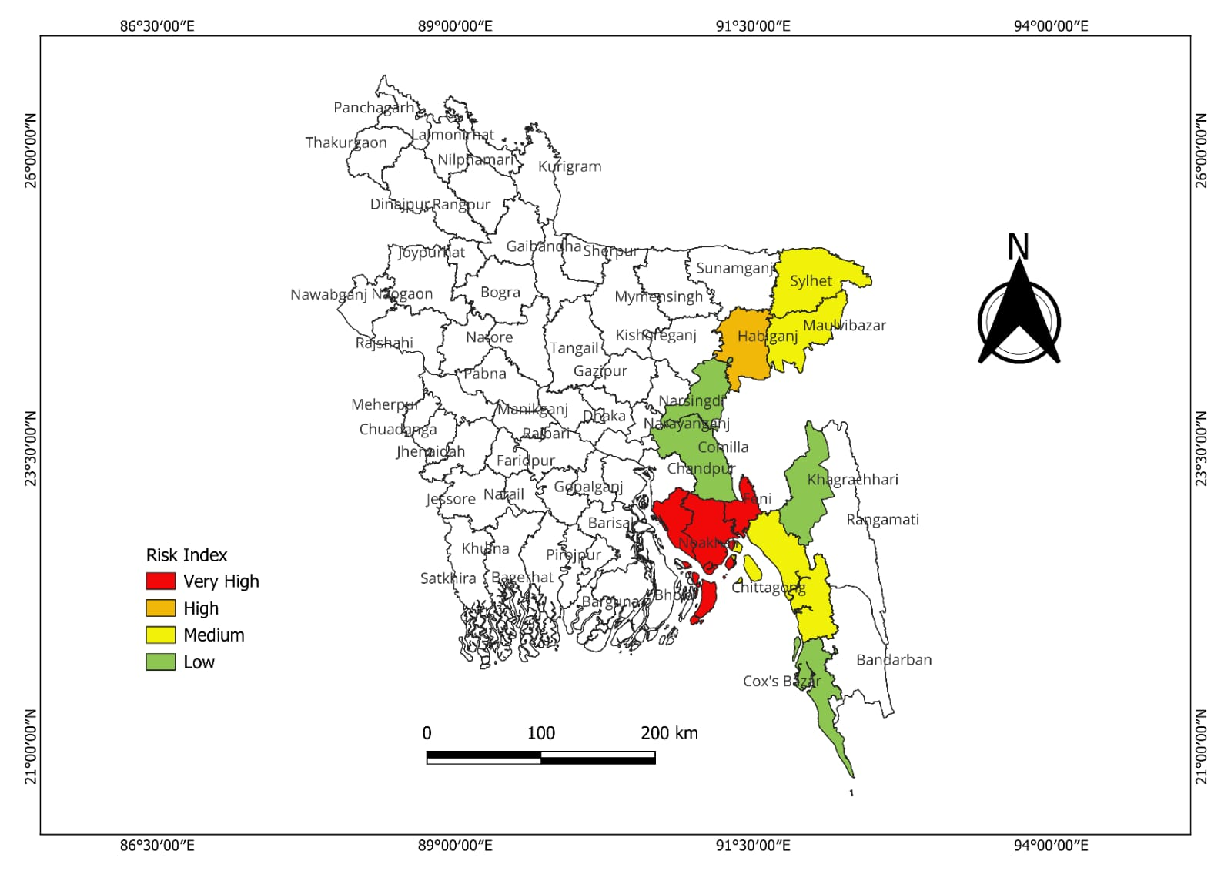
COMBINED RISK MAP
The Combined Risk Map

Slide 20
DISCUSSION AND CONCLUSION
The floods resulted in significant humanitarian and economic losses, impacting millions people and causing significant damage.
Noakhali, Feni, and Lakshmipur fall into Very High Risk category, while Sylhet, Cox’s Bazar, and Khagrachari face Low Risk.
Investment in flood-resilient housing, embankment construction, and improved drainage systems is necessary.
District-level risk zoning should guide resource allocation for better disaster management.

Slide 21
THANK YOU

